Slide 1





CyberSecurity Training
PHISHING AWARENESS
AND CYBERSECURITY TRAINING
Protect Yourself from Cyber Threats
Presented by:
Promise Anthony
September 19, 2026

Slide 2


Cybersecurity Training
September 19, 2026
WHAT IS PHISHING?
Phishing is a cyberattack designed to trick individuals into revealing sensitive information. Attackers pose as trustworthy entities to deceive victims into providing credentials, financial details, or personal data. These malicious tactics are used for credential theft, financial fraud, and malware infection.
Stealing login credentials and passwords
Committing financial fraud and identity theft
Installing malware on your devices
Gaining unauthorized access to systems

Slide 3

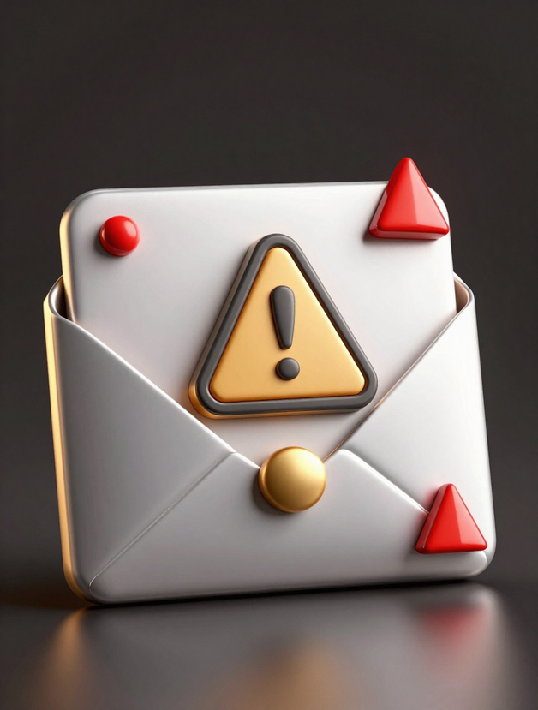
Cybersecurity Training
September 19, 2026
Suspicious Senders
Urgent Language
Check the sender's email address carefully. Attackers often use addresses that look similar to legitimate ones but contain subtle misspellings or use free email domains.
Phishing emails often create a false sense of urgency with phrases like "immediate action required" or threats of account suspension to pressure quick responses.
KEY PHISHING
EMAIL
INDICATORS
Poor Grammar
Professional communications are carefully proofread. Watch for spelling errors, awkward phrasing, or inconsistent formatting that may indicate a fraudulent message.
Being able to recognize phishing emails is your first line of defense against cyber attacks. Always examine emails carefully before clicking links or opening attachments. When in doubt, verify with the sender through a separate communication channel.
Unexpected Links
Be wary of unexpected attachments or links from unknown senders. Hover over links before clicking to preview the actual destination URL.

Slide 4
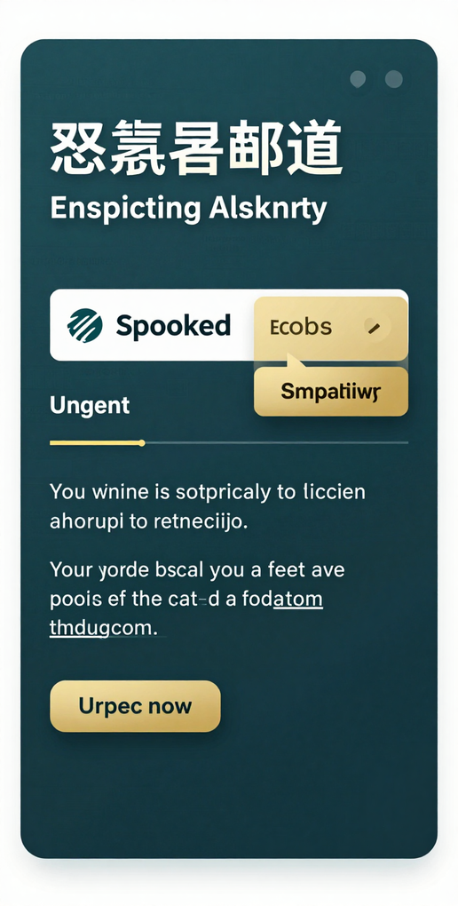


Cybersecurity Training
September 19, 2026
SAMPLE EMAIL
PHISHING
Suspicious Sender
ANALYSIS
Look for misspelled or unusual sender addresses. Attackers often spoof legitimate company names to gain trust.
This sample phishing email contains multiple red flags. Notice the sender address appears to be from a legitimate company but has slight spelling variations. The subject line uses urgent language to create panic and bypass critical thinking.
Urgent & Threatening
Phishing emails use urgent language like "immediate action required" or threats to create panic and bypass your critical thinking.
The email body contains grammatical errors and requests immediate action. Links appear to lead to the legitimate company but redirect to fraudulent sites. Always verify sender addresses and hover over links before clicking.

Slide 5

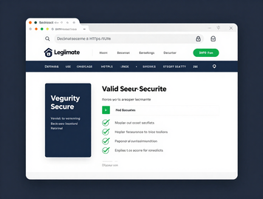

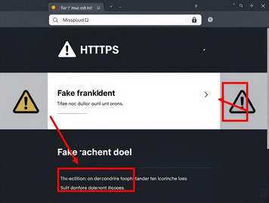

Cybersecurity Training
September 19, 2026
REAL VS
Legitimate Website Example
FAKE
Real website: Proper URL with HTTPS encryption. Consistent branding, professional design, and valid security certificate displayed.
COMPARISON
When comparing websites, always check the URL carefully for misspellings or unusual domain extensions. Look for HTTPS and valid security certificates. Fake sites often have poor design quality, inconsistent branding, and broken links. Real websites maintain consistent visual elements and proper security indicators.
Fake Website Example
Fake website: Notice the misspelled domain name and lack of HTTPS. The design is inconsistent with the legitimate site branding.

Slide 6

Cybersecurity Training
September 19, 2026
Pretexting
Baiting
Fabricating a believable scenario to gain your trust and extract information. Attackers create elaborate stories to appear legitimate.
Offering something enticing like free downloads or USB drives to lure victims. The temptation triggers curiosity and bypasses caution.
SOCIAL
ENGINEERING
TACTICS
Impersonation
Pretending to be a trusted figure like IT support, a manager, or a bank representative to gain access to systems or information.
Attackers use psychological manipulation to trick victims into revealing sensitive information. Understanding these tactics helps you recognize when someone is trying to manipulate you for malicious purposes.
Quid Pro Quo
Offering a service or favor in exchange for information. Common in tech support scams where help is offered for credentials.

Slide 7

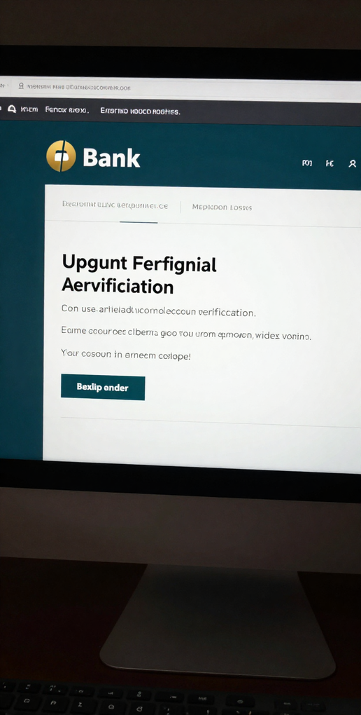
Cybersecurity Training
September 19, 2026
PRACTICAL
EXERCISE 1
Identify 5 Red Flags
SPOT THE PHISHING EMAIL
Check for: suspicious sender address, urgent language, poor grammar, unexpected attachments, and suspicious links.
Below is a sample email containing multiple suspicious elements. Use the checklist on the right to identify each phishing indicator. Take a moment to analyze the email carefully before moving on.
Mark Each Indicator
Circle or highlight each suspicious element in the email. The more you practice, the easier it becomes to spot phishing attempts.
After completing the checklist, discuss your findings with your team. Compare answers and explain why each element is suspicious. This hands-on practice helps build the skills needed to recognize real phishing attempts.

Slide 8

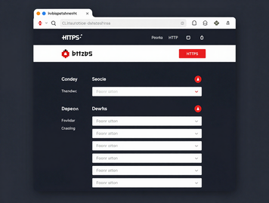
Cybersecurity Training
September 19, 2026
SPOT THE
Real Website
FAKE
This is the REAL website. Notice the clean URL, HTTPS security indicator, and professional design.
WEBSITE
Take a close look at both websites. Which one looks fake? Check the URL for misspellings or unusual domains. Look for HTTPS and valid security certificates. Notice any poor design, inconsistent branding, or broken links. Discuss with your team what clues helped you identify the fake site.
Fake Website
This is the FAKE website. Notice the misspelled URL, missing security certificate, and poor design quality.

Slide 9

Cybersecurity Training
10 September 2026
Verify Sender
Enable MFA
Always verify the sender's email address before clicking links or opening attachments. Look for subtle misspellings or unusual domain names that may indicate a fake sender.
Enable multi-factor authentication (MFA) on all your accounts. This adds an extra layer of security beyond passwords, making it much harder for attackers to gain access.
ONLINE
PREVENTION
SAFETY
Update Software
Keep your operating system, applications, and antivirus software up to date. Security patches protect against known vulnerabilities that attackers exploit.
Protecting yourself from phishing attacks starts with simple, consistent practices. By following these essential prevention tips, you can significantly reduce your risk of falling victim to cyber threats. Stay vigilant, think before you click, and make security a daily habit.
Strong Passwords
Use strong, unique passwords for each account. Consider using a password manager to generate and store complex passwords securely.

Slide 10

Cybersecurity Training
September 19, 2026
REAL-WORLD EXAMPLE 1
In 2024, a major Fortune 500 company fell victim to a sophisticated phishing attack. An employee received an email appearing to be from a trusted vendor, requesting urgent payment information. The attacker successfully compromised the system, leading to significant consequences.
Data breach affecting over 500,000 customer records
Financial loss exceeding $50 million in damages
Severe reputational damage and lost customer trust
Regulatory fines and ongoing legal consequences

Slide 11
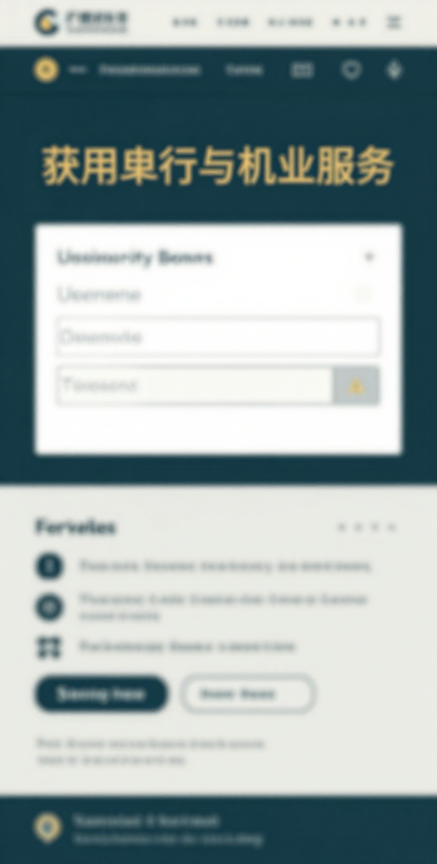
Cybersecurity Training
September 19, 2026
REAL-WORLD EXAMPLE
FAKE BANKING
Always verify the URL
WEBSITE
Check for HTTPS and valid security certificates. Even small URL differences can indicate a fake site designed to steal your credentials.
A criminal group created a convincing replica of a legitimate bank's login page. The fake site used identical branding, logos, and layout to trick users into entering their credentials.
Bookmark official sites
Never click bank links from emails or messages. Always navigate directly to official banking websites by typing the URL yourself.
Over 50,000 users unknowingly entered their username, password, and account details into the fraudulent site. Many victims suffered financial losses, unauthorized transfers, and identity theft.

Slide 12
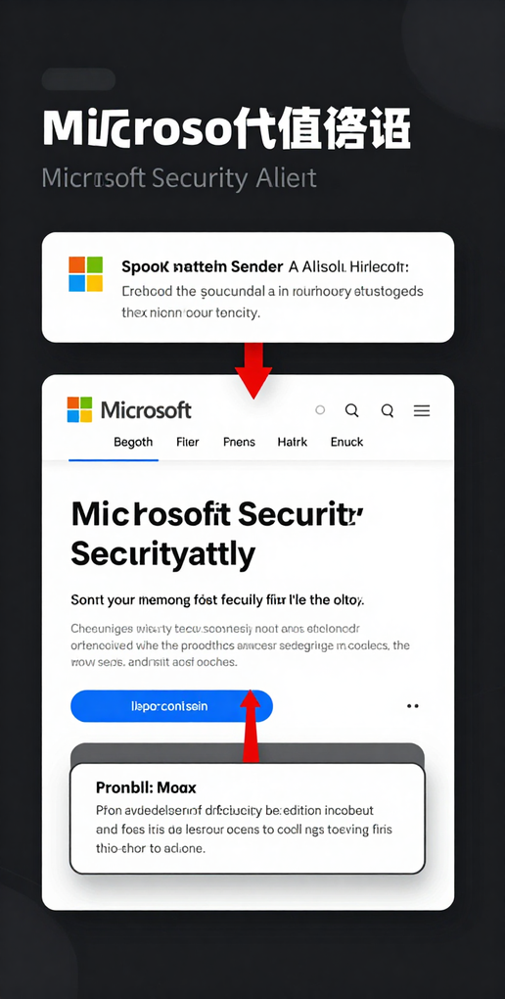
Cybersecurity Training
September 19, 2026
REAL-WORLD
EXAMPLE 3 —
Suspicious Links
MICROSOFT PHISHING EMAIL
Links redirect to fake login pages that look identical to Microsoft sites but capture your credentials when entered.
This phishing email pretends to be from Microsoft, targeting users with urgent language about account security. Attackers use spoofed Microsoft branding and logos to appear legitimate and gain trust.
Spoofed Branding
Attackers copy Microsoft logos and design elements to appear authentic. The sender address often contains subtle misspellings.
Even trusted brands can be faked. Always verify sender email addresses, check for suspicious links before clicking, and never enter credentials in response to unexpected emails claiming urgent action is needed.

Slide 13
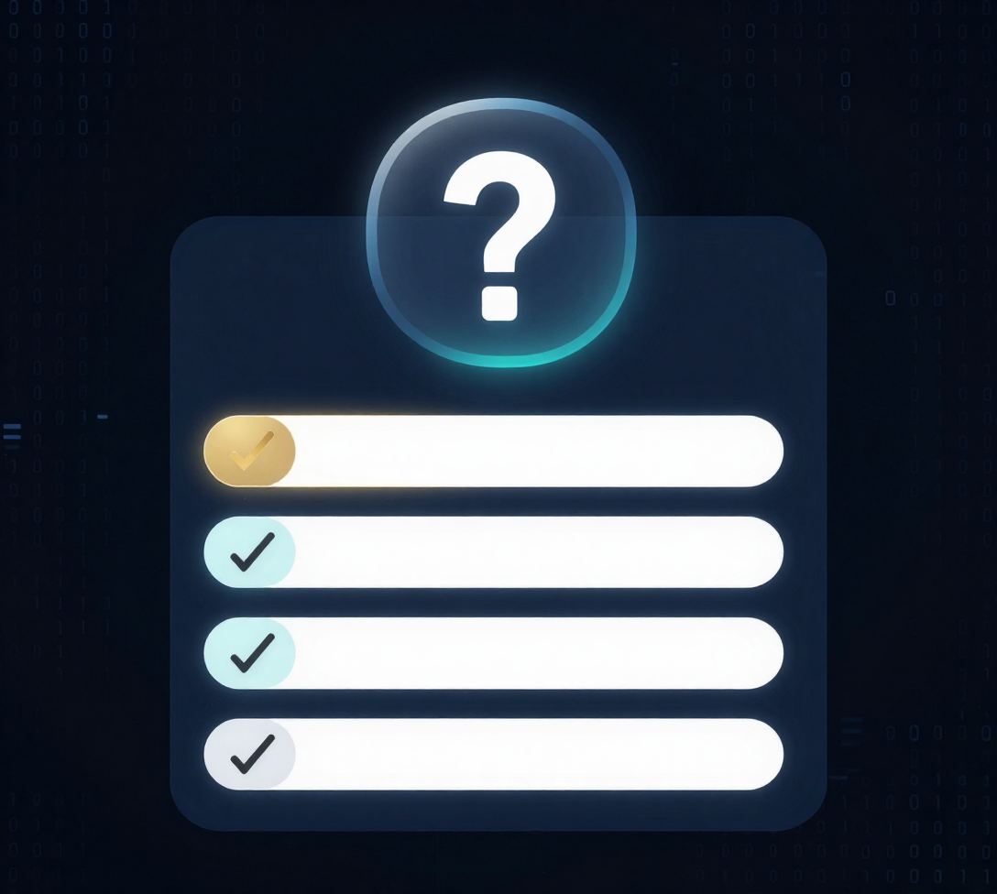
Cybersecurity Training
September 19, 2026
INTERACTIVE QUIZ
Test your phishing awareness knowledge with these questions. Choose the best answer for each question. Take your time and think carefully about what you've learned in this training session.
Which is NOT a common phishing email indicator?
True or False: Emails from unknown senders are always phishing.
What is the safest response to a suspicious email?

Slide 14
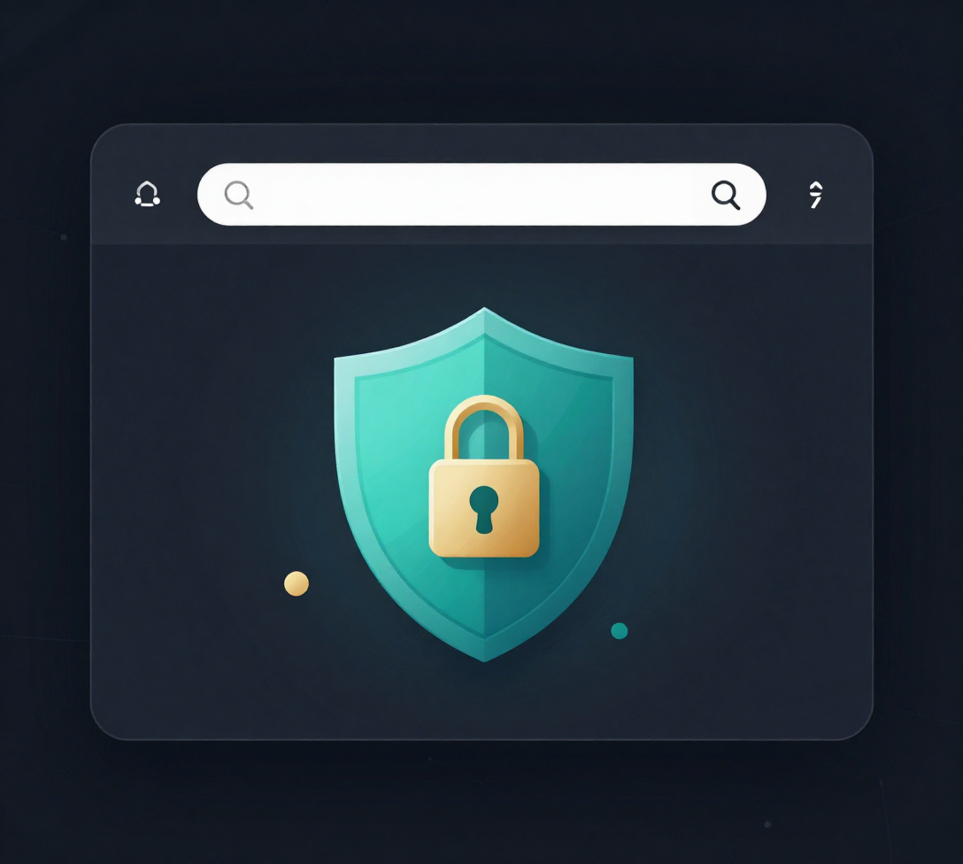
Cybersecurity Training
September 19, 2026
INTERACTIVE QUIZ — QUESTIONS SET 2
Test your knowledge of identifying fake websites and safe browsing practices. Select the best answer for each question. Take your time to think through each scenario carefully.
What should you check to verify a website's legitimacy?
Which of the following URL patterns is most suspicious?
What is the BEST response when a website asks for sensitive data unexpectedly?
True or False: A website with HTTPS is always safe and legitimate.

Slide 15




Cybersecurity Team
THANK YOU
FOR YOUR ATTENTION
promiseanthony3953@gmail.com
www.codealpha.tech
Presented by:
Promise Anthony
19 September 2026
Stay Alert, Stay Safe!

